Slide 1

Weekly update
Phone localization
Sowmiya Murugiah
50485124

Slide 2

AWS Integration
I tried creating amazon AWS services
It is asking for payment option it will take 24 hrs to create account and will take 1$ as price for the payment verification

Slide 3

Accessing information about other devices on a Wi-Fi network typically requires administrative privileges or access to network APIs that are often restricted.

Slide 4
Below are the breakdown of Components: 1. Data Collection: Collects raw phone details 2. Preprocessing Node: Cleans and processes raw data 3. Inference Node: Utilizes machine learning models to infer information 4. Local Database: Stores raw, processed, and inferred data 5. Deployment using Docker: For containerization and easy deployment 6. Resource Allocation: Allocate GPU, memory, and CPU for efficient processing 7. Launch and Testing

Slide 5
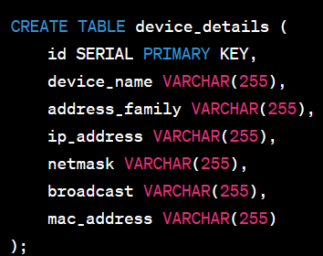
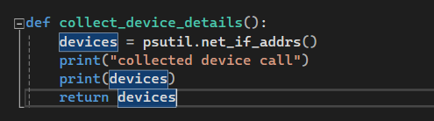
1. Data Collection Node: Collects raw phone details.
Python code is written to collect details and store it in the table “device_details”. Libraries like psutil or pyshark is used to gather device information.
Below database table is created

Slide 6
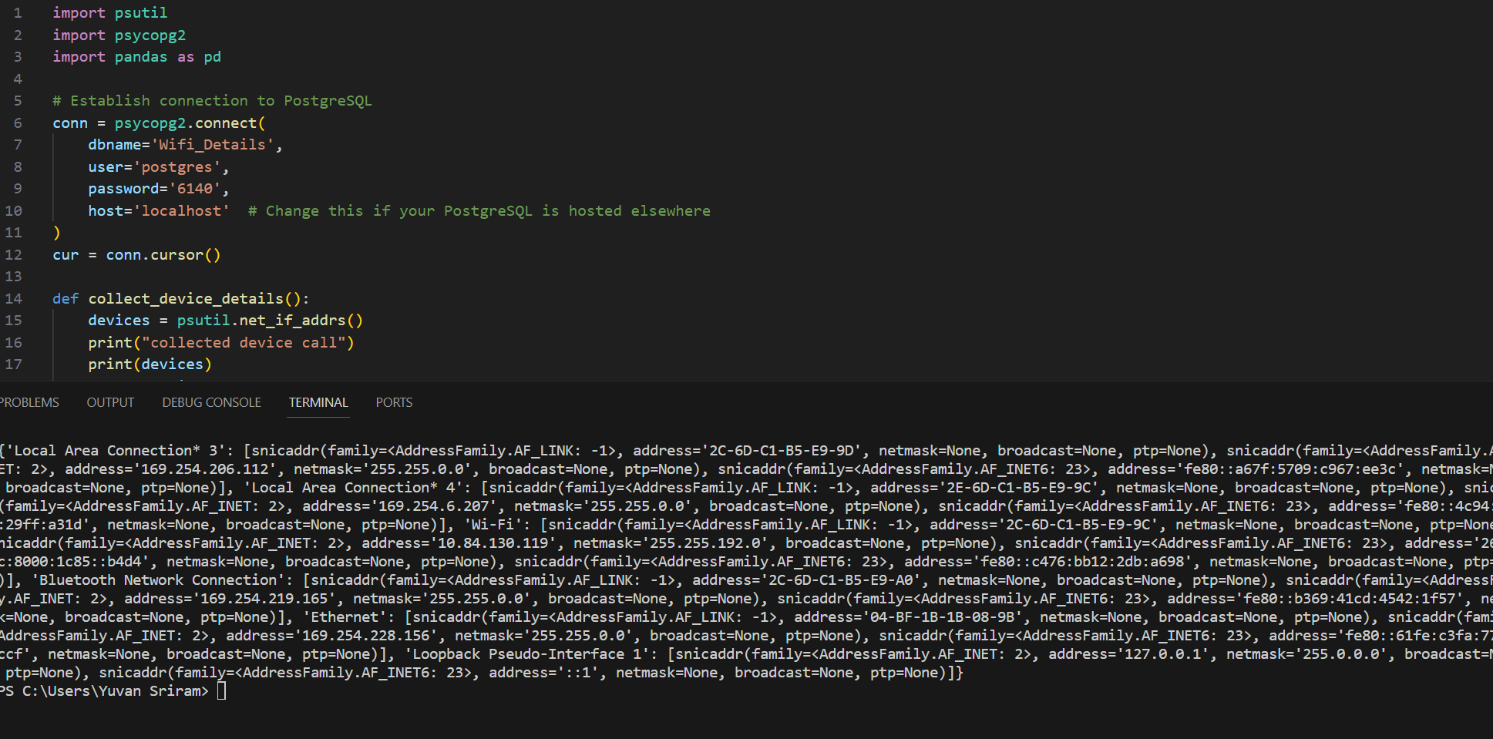
Net_if_addrs details are printed in the console

Slide 7

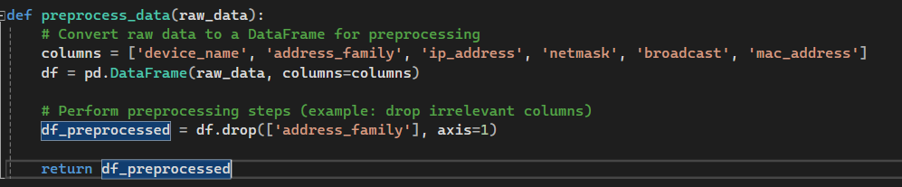
2. Preprocessing Node: Cleans and processes raw data.
Separate function is written in python to preprocess the data as per our need

Slide 8

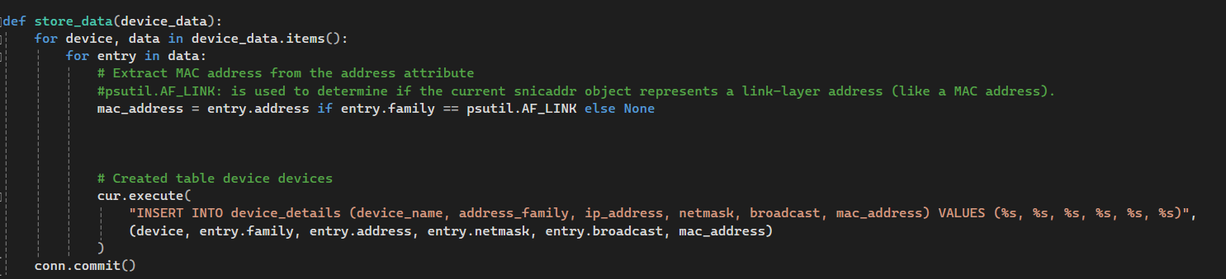
4. Local Database: Stores raw, processed, and inferred data
Below code is written to store data that is preprocessed after collection. It stores in the PostgreSQL database on the local server

Slide 9
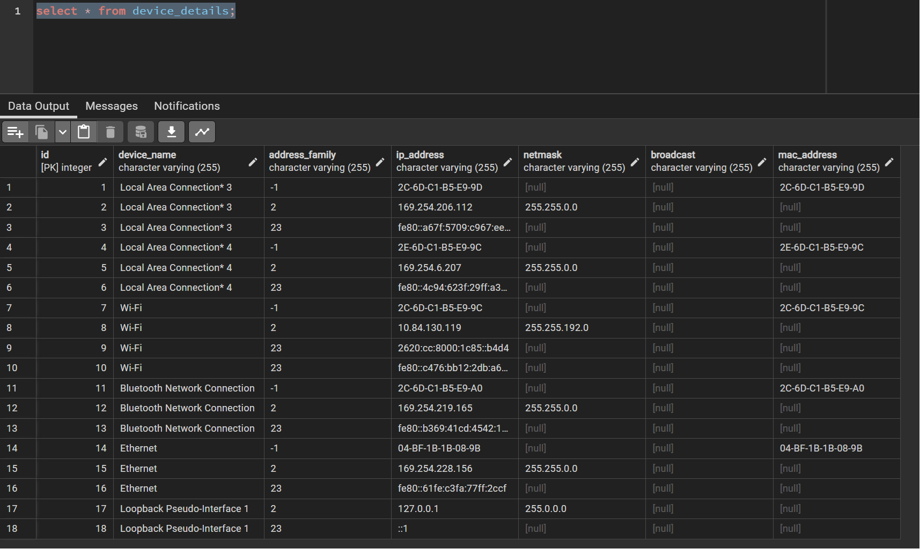
4. Local Database: Stores raw, processed, and inferred data
Stored data in database shown by querying in db

Slide 10
Next Step
1. To get more idea about what are the further preprocessing required and what machine learning algorithm to be applied and below steps to be enhanced
2. Inference Node: Utilizes machine learning models to infer information
3. Deployment using Docker: For containerization and easy deployment(Installed docker but need to create separate image for each node – collection, preprocessing, inference and database)

